Slide 1

Team FigJam
Payne Miller | John Hiott

Slide 2
What is the problem?
Access to care: where do I go to address my medical needs without inducing financial hardship on myself?
MedLink needs a platform to combine all it’s low-cost clinical data into one mobile location, so that the populous has access to empowering information that could improve their Quality of Life. It took us an hour of research to find these clinics on a laptop, which 9 out of 10 individuals living below the poverty line do not have, as mobile phones are there only means of connectivity.

Slide 3

Our solution
A business ready, deployable, mobile and backend solution that allows users to identify clinics that best suit their medical and socioeconomic needs.
Complete Android app with Google Maps, Phone, and Web Browser integration
A functioning cloud RESTful API serving up MedLink’s publicly facing data.
An intuitive User Experience allowing users to quickly find the clinic they need.

Slide 4
Our advantages
Ability to work quickly since this is not our first hackathon together.
We know our strengths and wanted to provide a solution that played in to them.
Even though we did not work with big data, we were able to find a need and provide a solution.

Slide 5
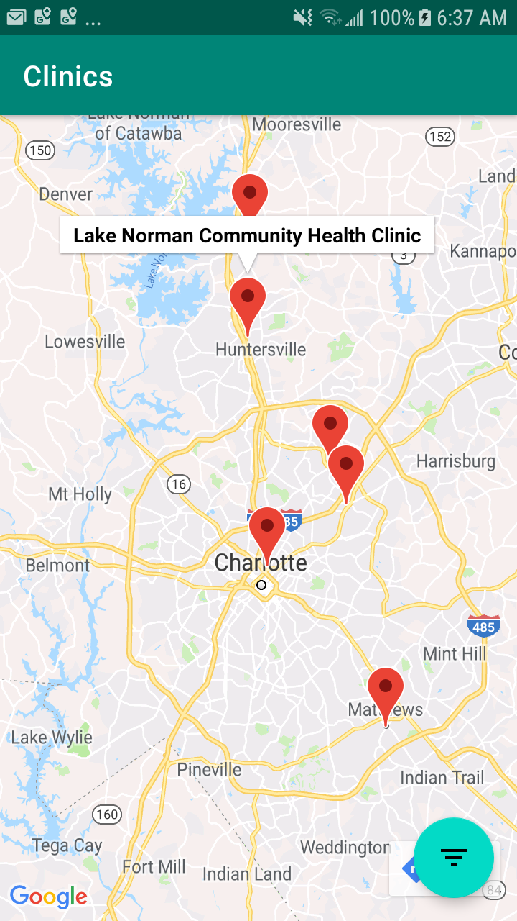
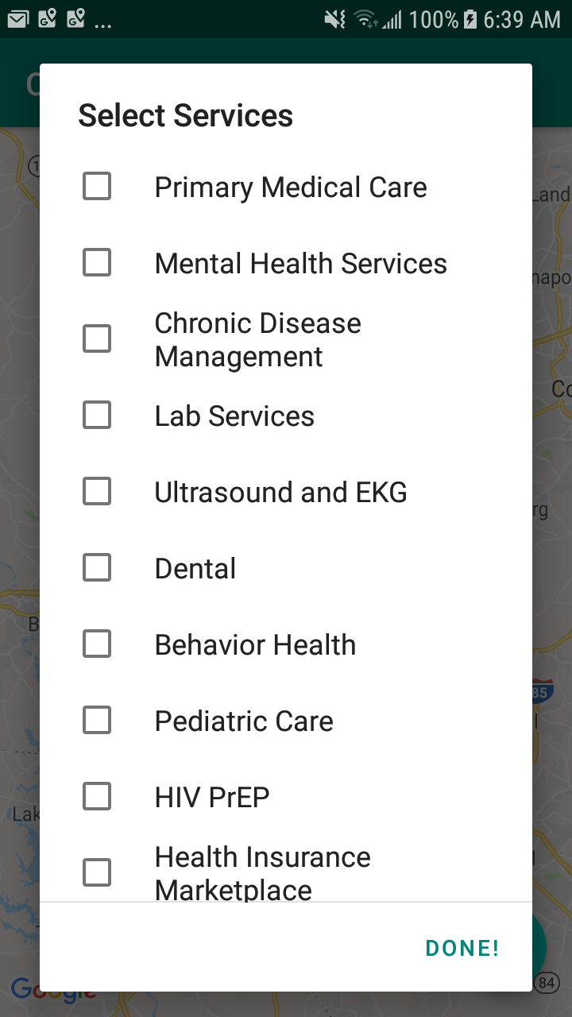
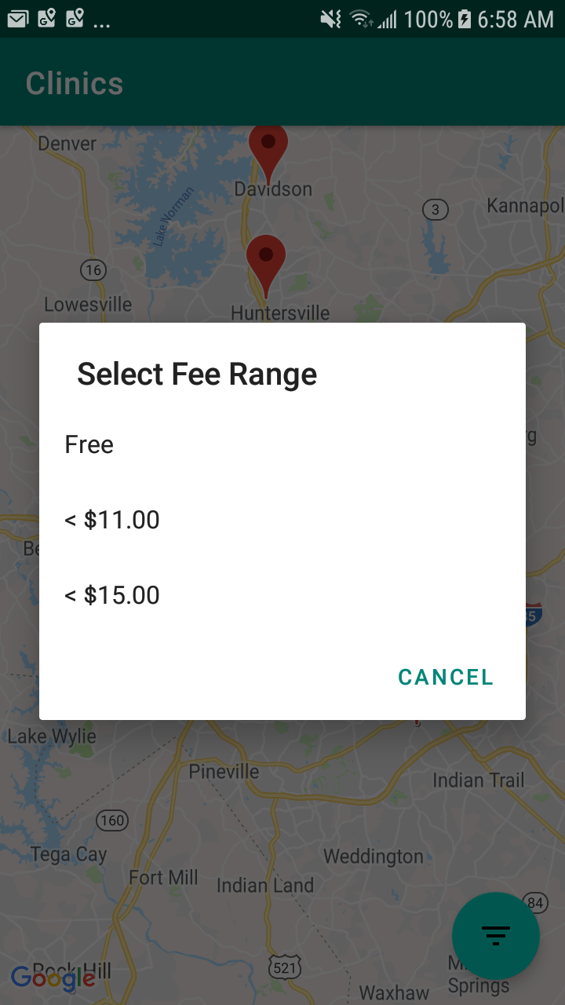
Product overview

Slide 6
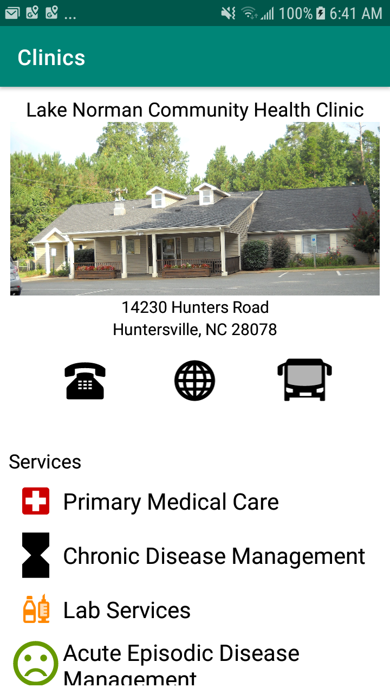
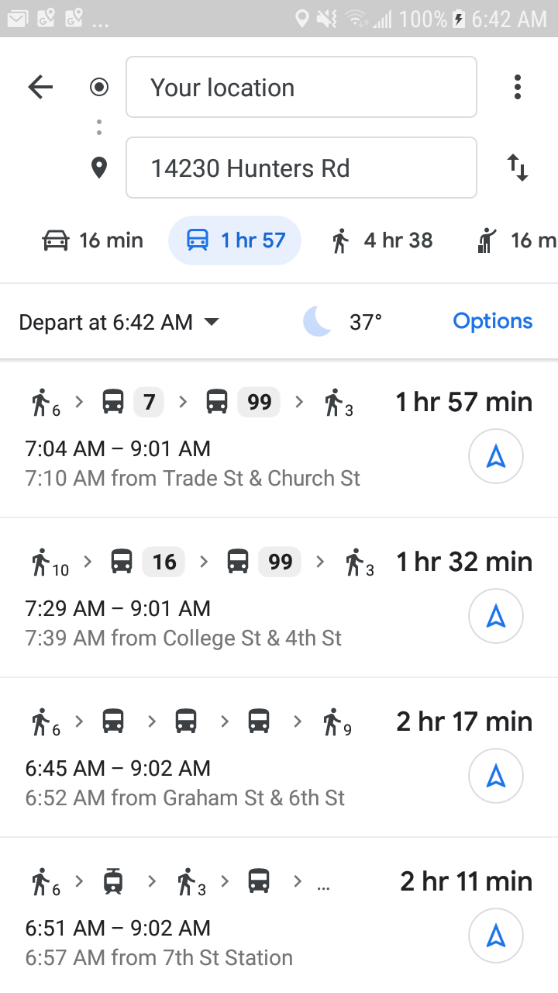
Product overview

Slide 7
Our best features
Ability to graphically view and filter clinics on a Map
Uses the mobile platform because it provides connectivity to more lower income individuals/families
Ability to find transportation to clinics ranging from cars to public transportation

Slide 8

The sky is the limit
Our solution is business ready and fully deployable. Encompassing both the mobile front-end and an API, the possibilities are rich with our platform!

Slide 9
Demo time

